Slide 1
Forget everything you know about payments.

Slide 2
Peer to peer payments are here
Store Charge Coins (Tokens)
True
Mobile
Banking
DigiCash
Bitcoin
(China) First Minted Money
(India) First International Checks
Plastic Amex
1000 BCE
0 BCE
900
1865
1959
1986
2009
2018
National Treasury
Bank
Merchant
Individual/ Business
500 BCE
500
1500
1950
1970
2004
2015
(Amsterdam) Checks with #
Diners Club
Check 21
Remote Deposit
EMV
Ethereum
(India)
First Checks
Magnetic Stripe

Slide 3

The world of retail ecommerce ($2 T)

Slide 4

The world of retail commerce ($24 T)

Slide 5

90% of retail commerce is analog

Slide 6
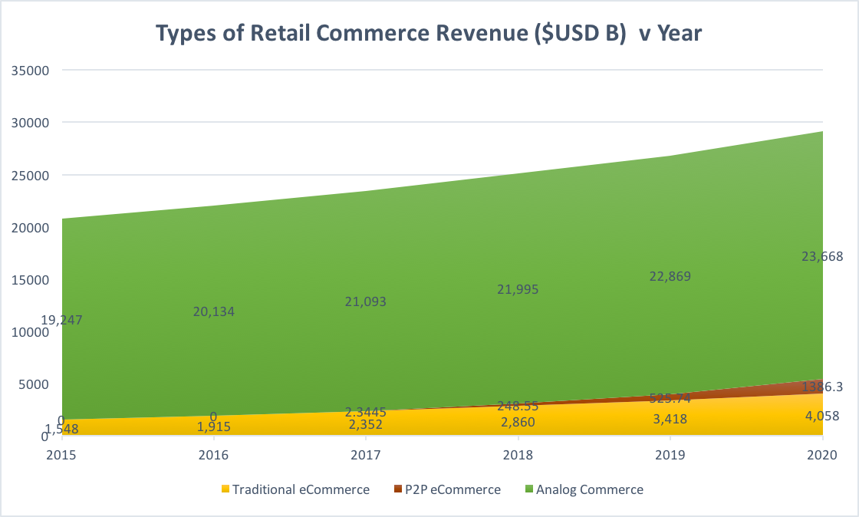

Slide 7

In 45 years Credit Card Merchants have only been able to serve 10% of the retail market.
Roughly 10% annual growth even with upstarts like..

Slide 8
Fraudless transactions

Slide 9
Show Evidence

Slide 10
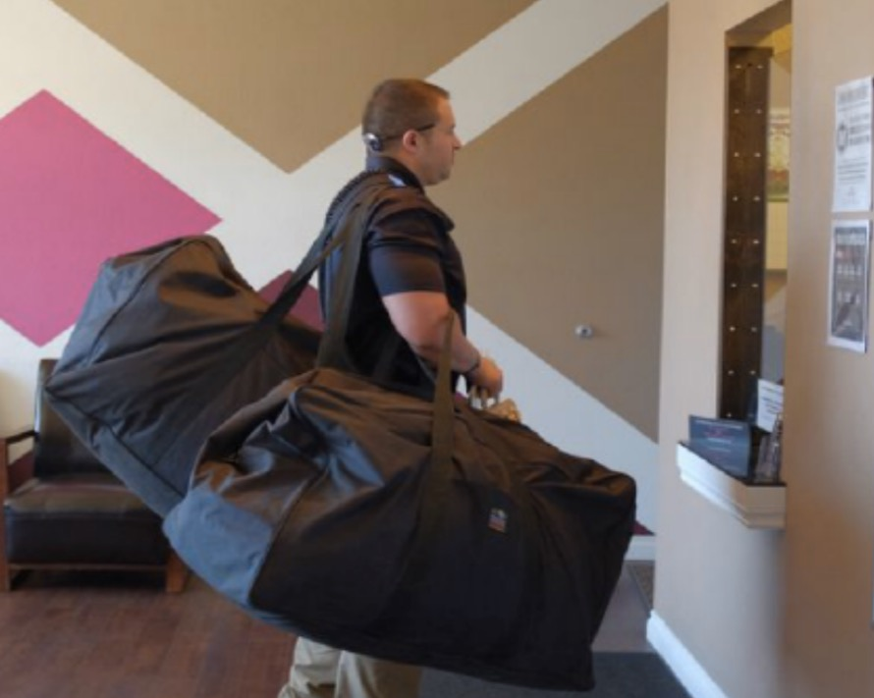
But the Unbanked are Left Out
Unbanked businesses can’t use electronic commerce.
So…
They get paid in cash
They pay bills in cash
And they store cash…
http://www.usatoday.com/story/news/nation/2014/09/04/legal-marijuana-workers/15000903/
Notes:
… and this means that the unbanked businesses do not have access to those electronic commerce tools. Back to the problem – if you cannot get a bank account. You get paid in cash. You pay your bills in cash. You store cash. Of course there are many companies that cannot get bank accounts for some reason or another. Right now the poster child for unbanked businesses is the legal cannabis industry.

Slide 11
